Slide 1

Lego DOE
Ayush Srivastava
Morris Lu
Abhishek Kumar
Sanjana Ramesh

Slide 2
Objective
Maximize the distance travelled by the car

Slide 3
Experimental setup
Team room MCRD 215 (controlled indoor environment) – no wind resistance
Used a white board as ramp with inclination of 30 degrees
Carpet floor (so there is some friction)
The Ramp was 110 cm

Slide 4
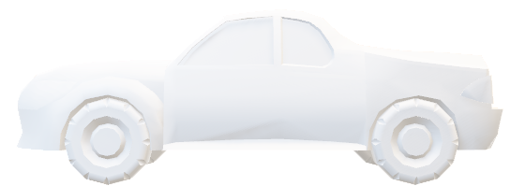
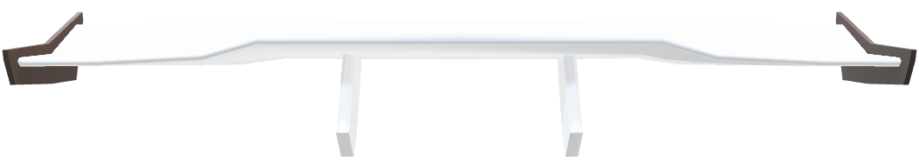
Response Variable
Distance = starting from end of the ramp to the distance travelled by the car
How we measured: Using the measuring app in iPhone
DISTANCE

Slide 5
Factors chosen
A Size of the Wheel ( high – Big wheel , low – Small wheel )
B Length of the Car ( high – Long car , low – short car)
C Wings ( high – with wings , low – without wings )
D Heights ( high – with height , low – without height )

Slide 6
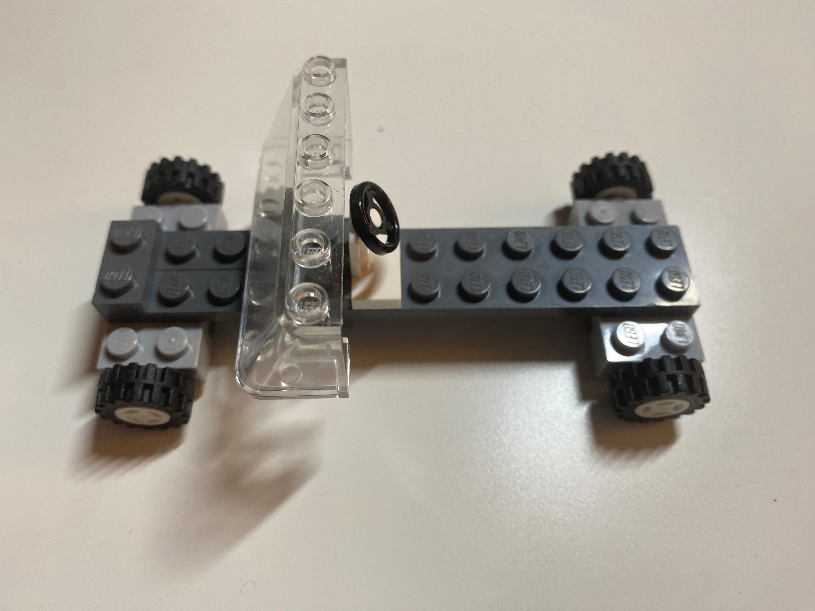
(1)
Base Model:
All factors are at low level
Reason: Minimize the cost and stable

Slide 7
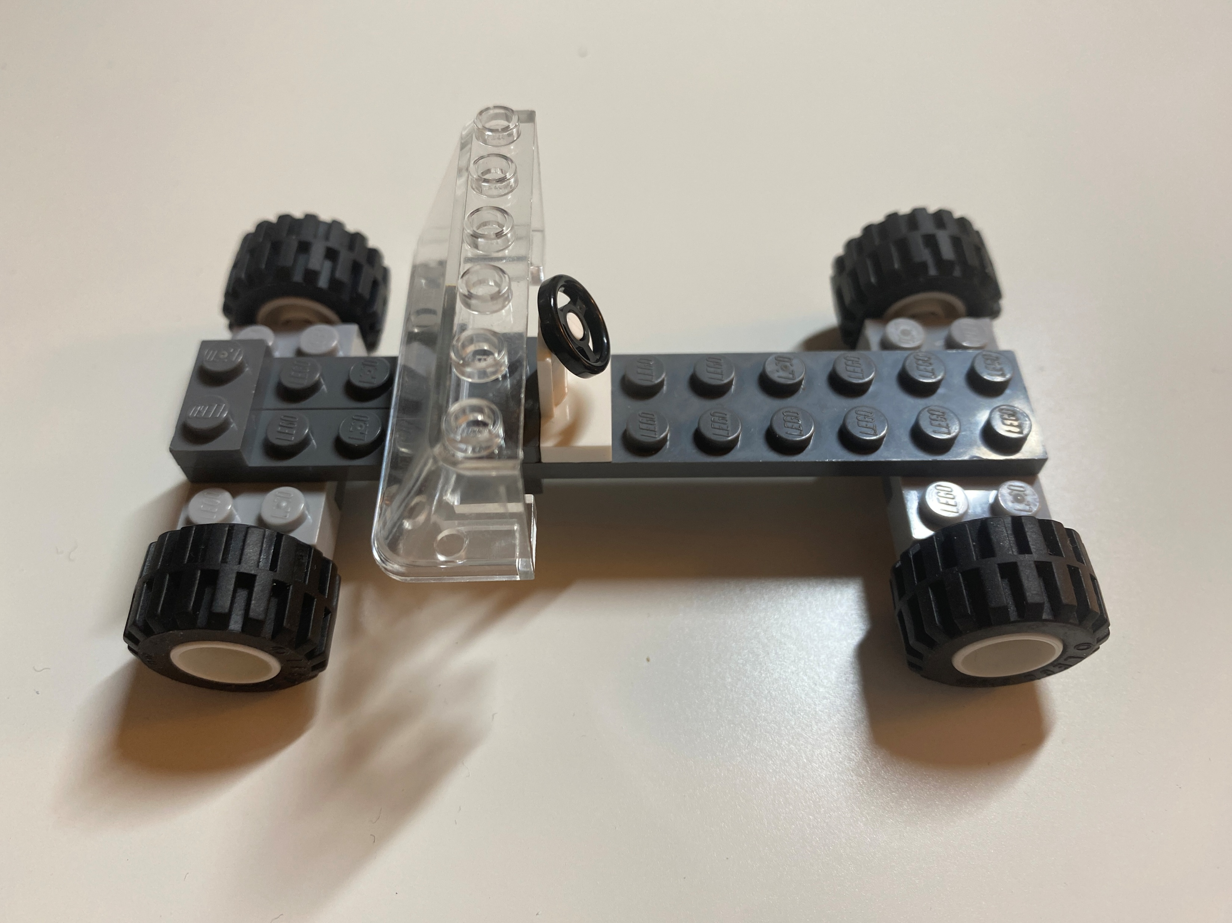
A
Model A:
A is at High level (Big Wheel Size)
Reason: different sizes of wheel causes the center of gravity to change hence affecting the speed in both scenarios

Slide 8
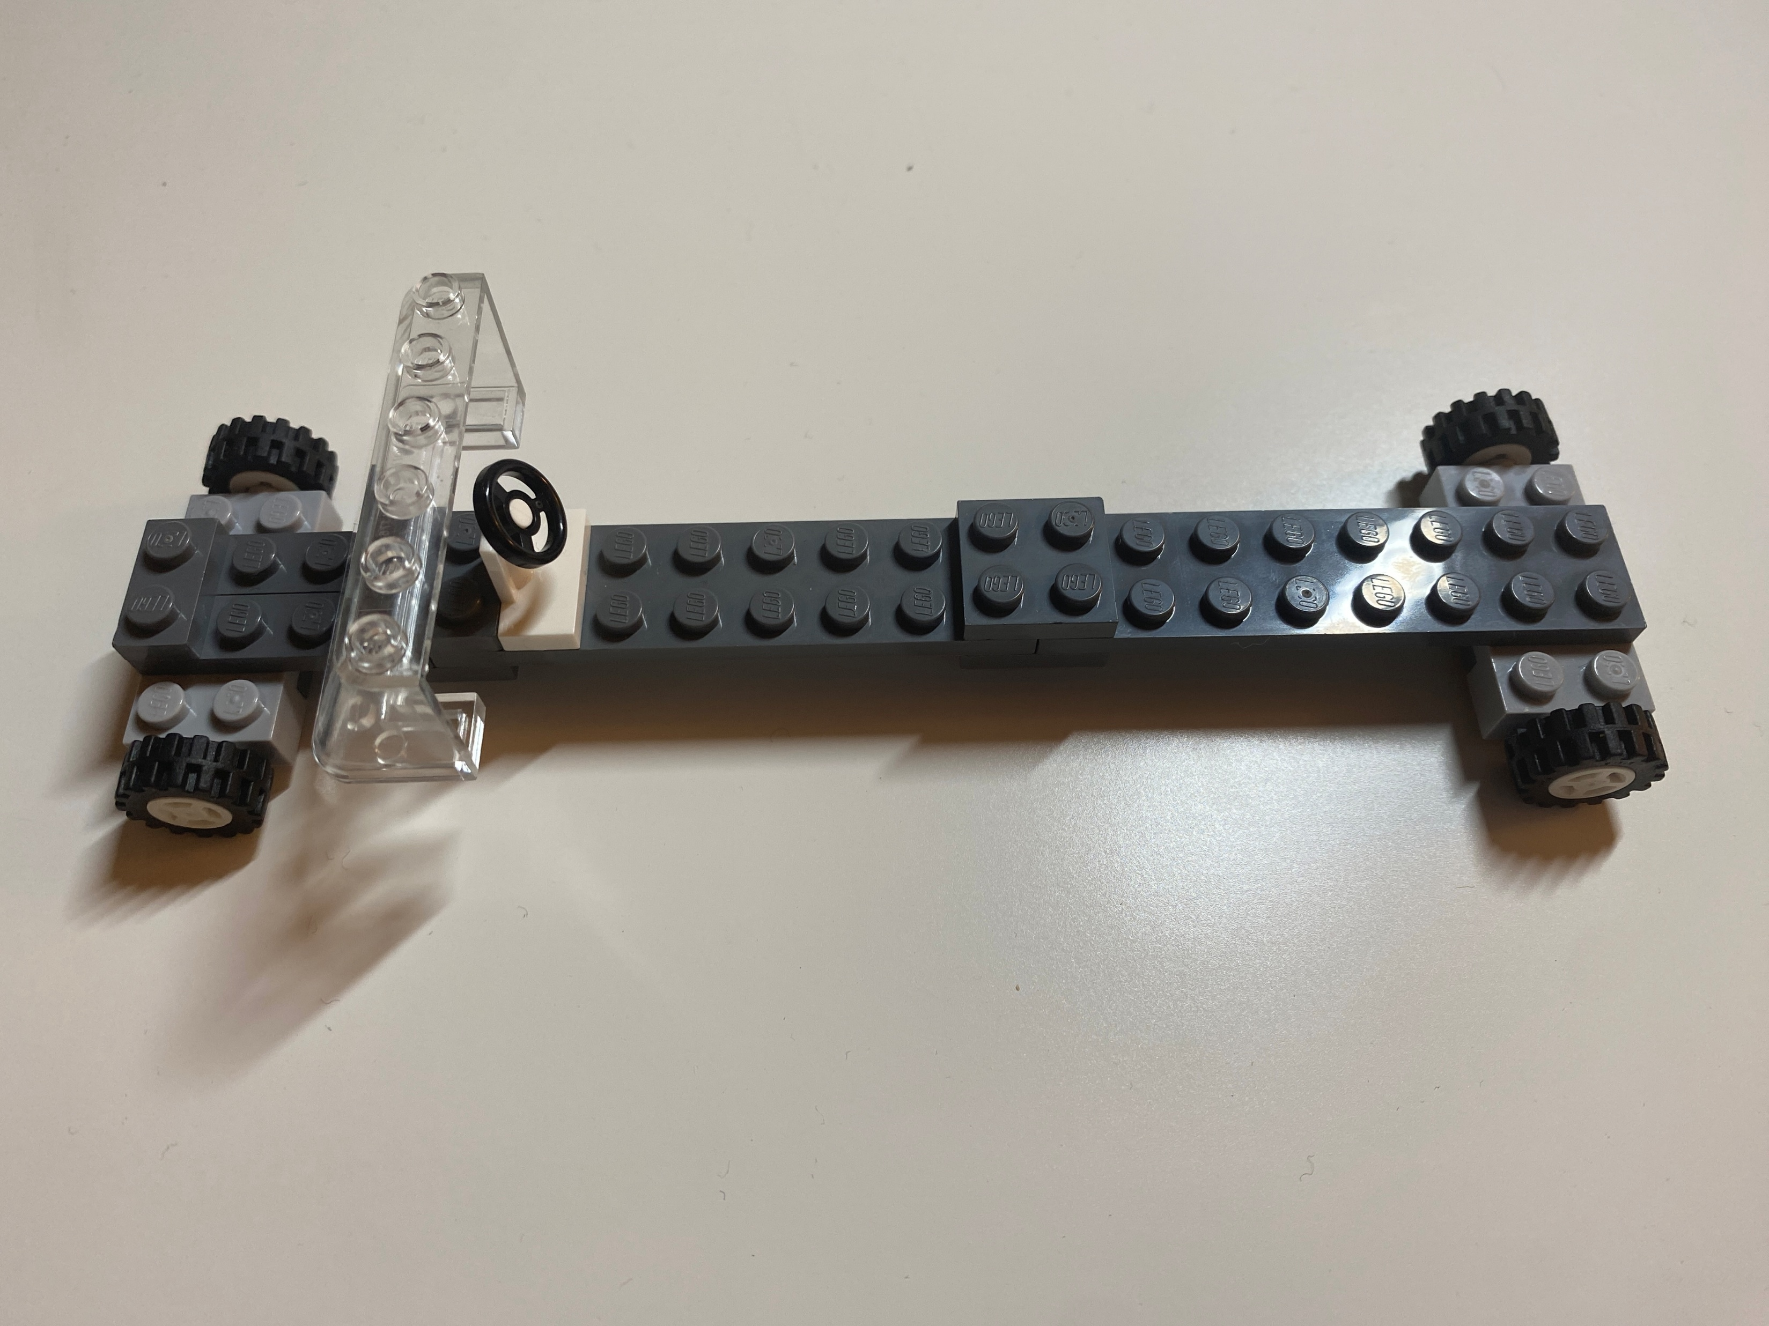
B
Model B:
B is at High level (Long Car)
Reason: different length of the car again causes the center of gravity to change hence affecting the speed of the car

Slide 9
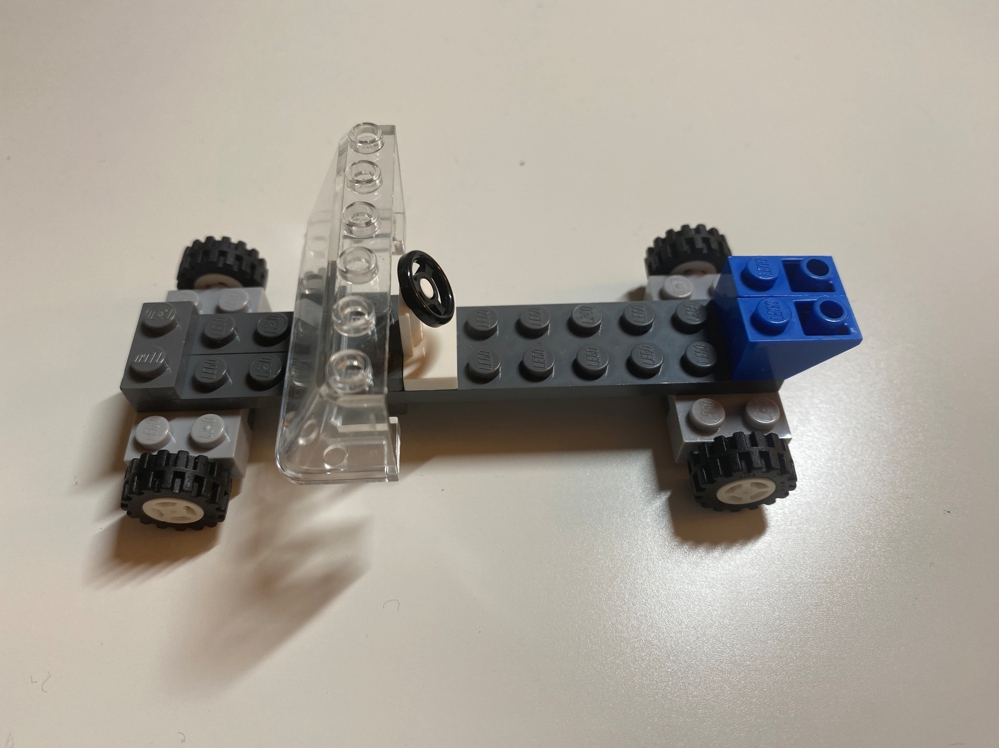
C
Model C:
C is at High level (With Wings)
Reason: adding wings causes changes in aerodynamics hence affecting the speed of the car

Slide 10
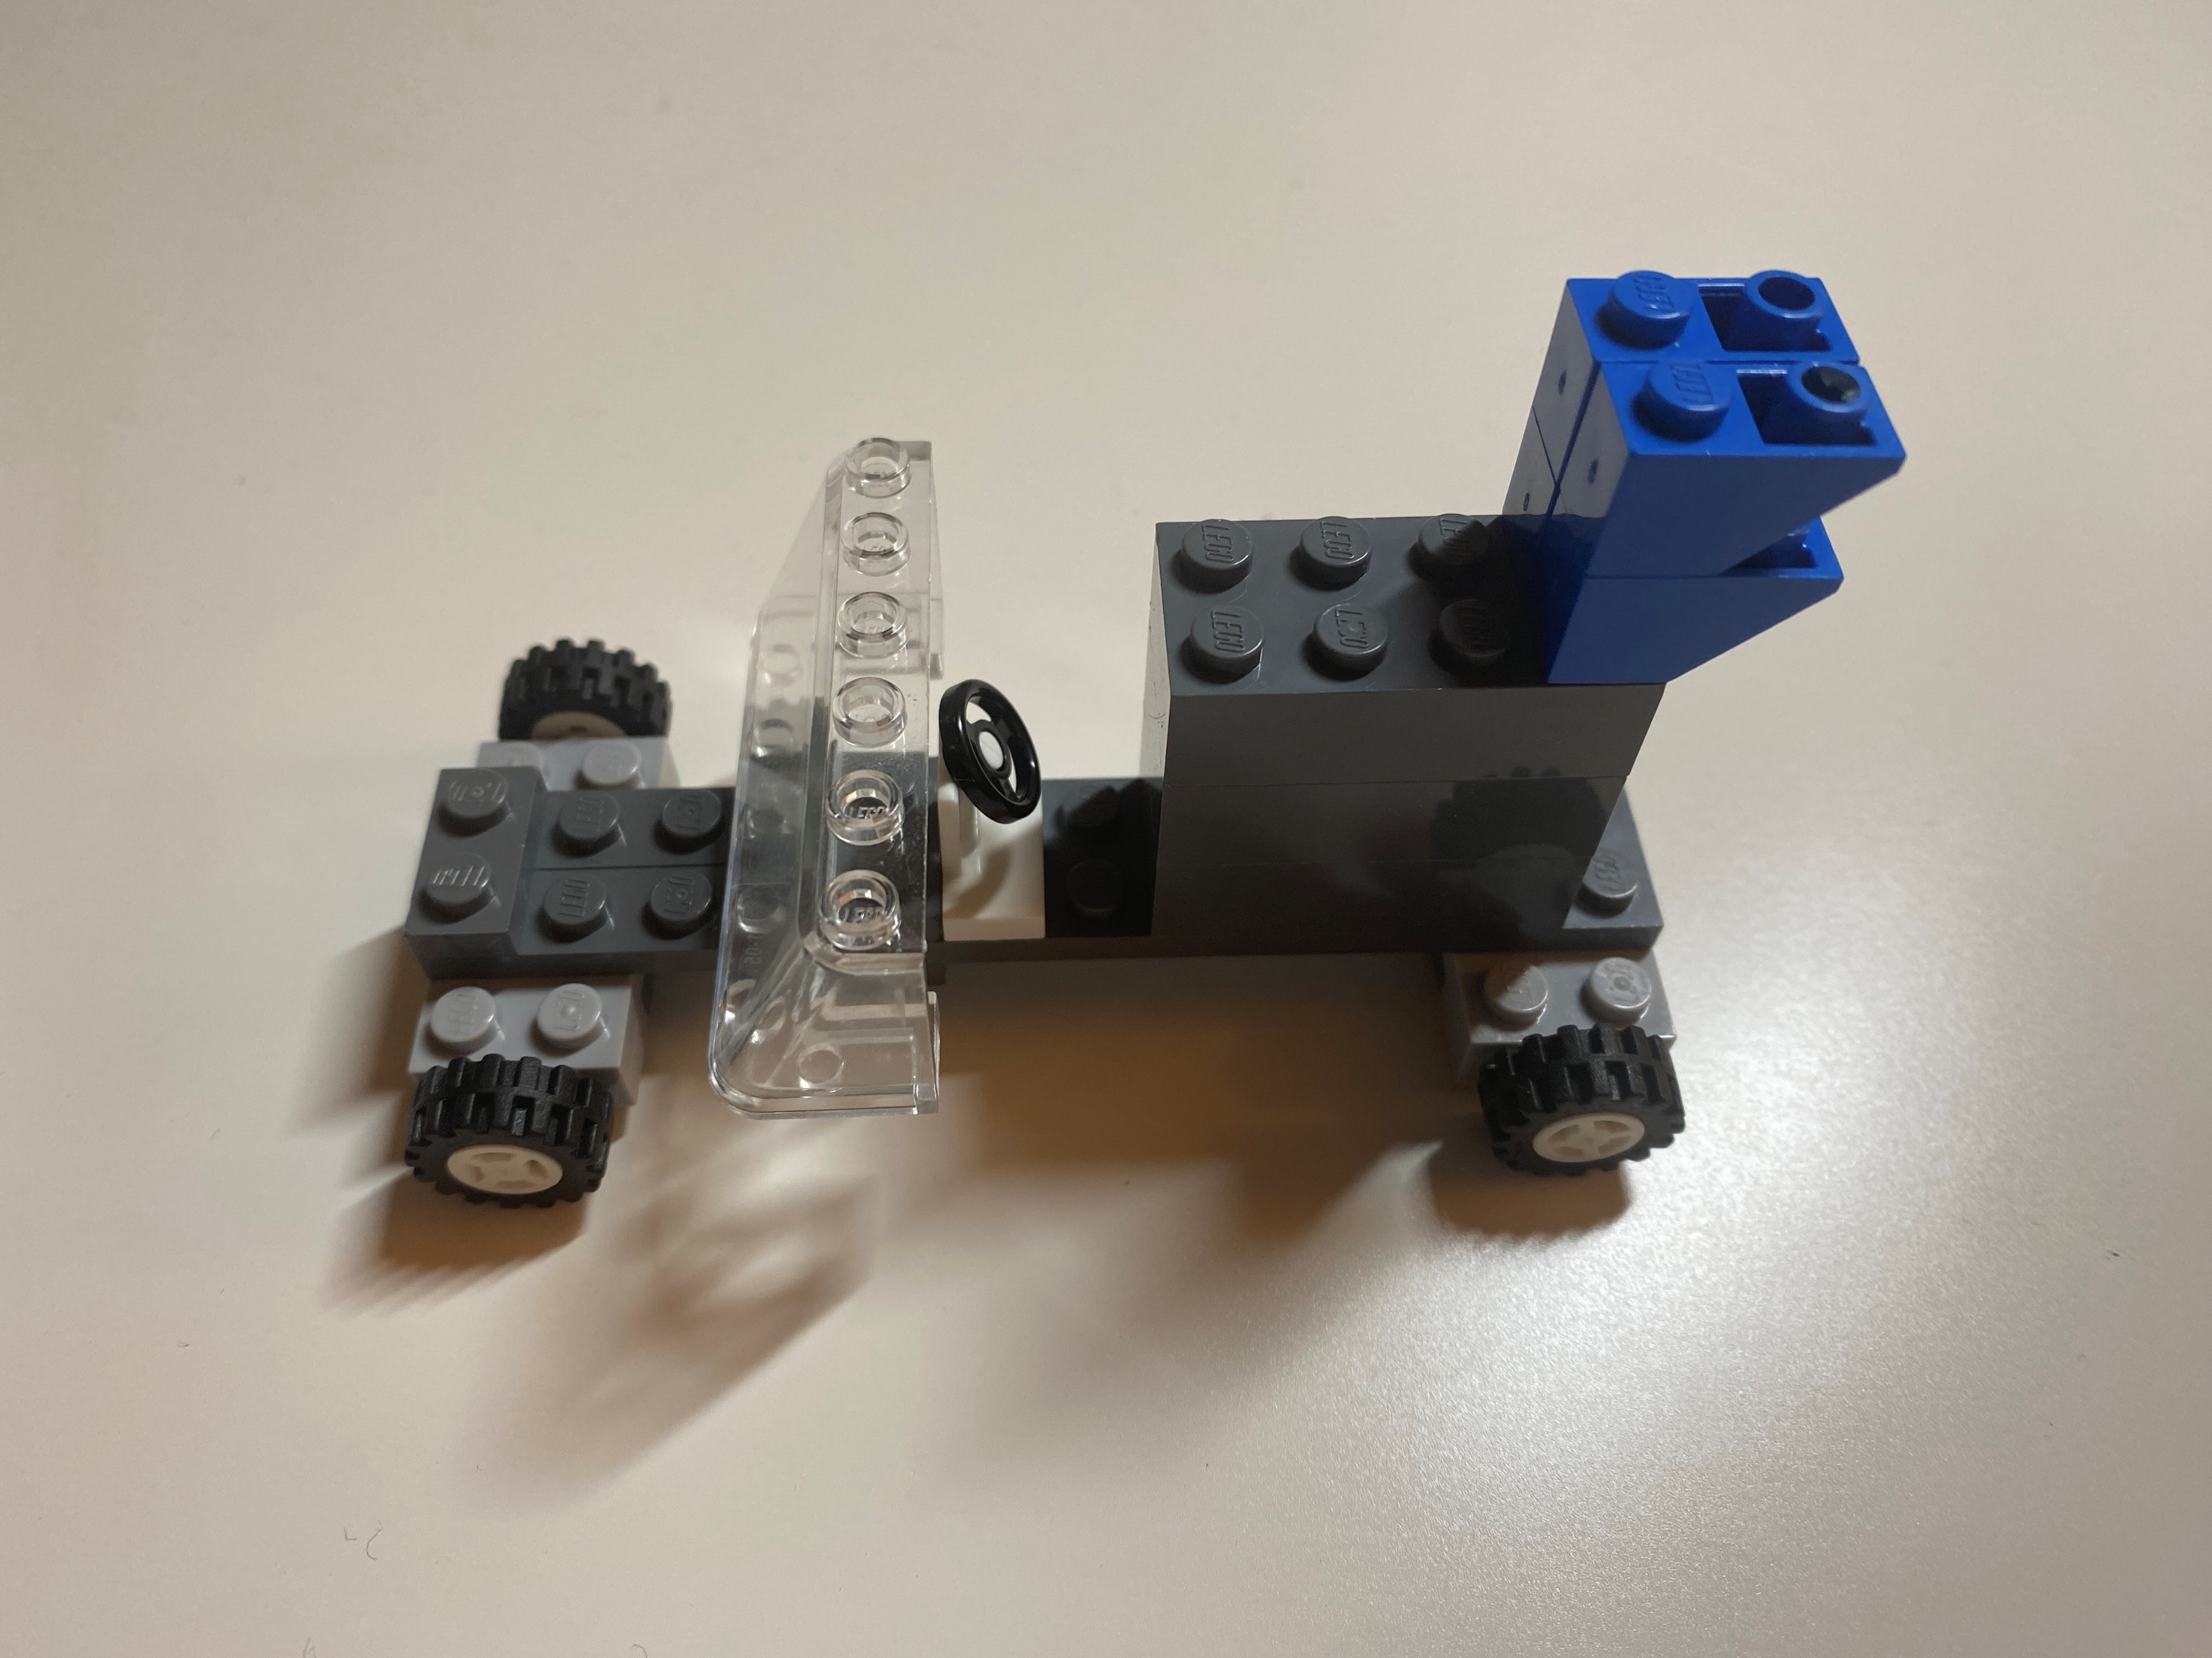
D
Model D:
D is at High level (With Height)
Reason: adding more height to car again cause the center of gravity changes as wells increases the air friction

Slide 11
Experimental Design
Full Factorial
Levels: 2
Factors(k): 4
Replications(n): 3
Observations: 3*2^4 = 48

Slide 12
How did we do it ?
We dropped the car at the same spot and made sure the launch of the car is from same height and same angle each time trying to release variability as much as we could.

Slide 13
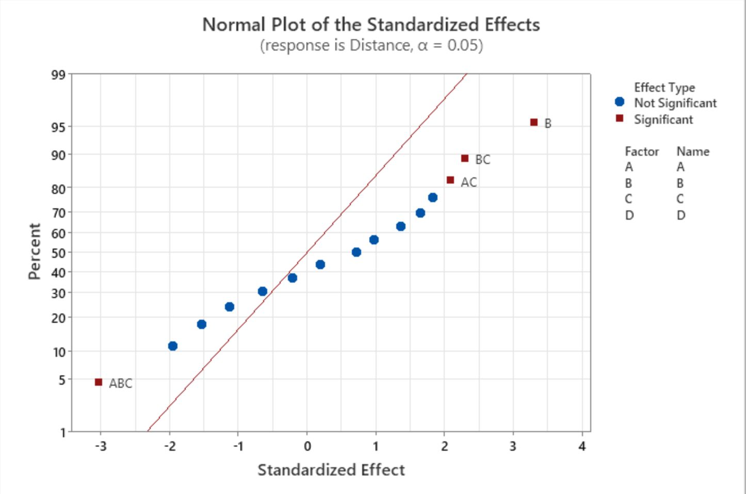
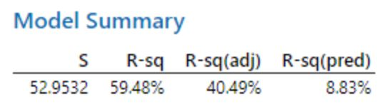
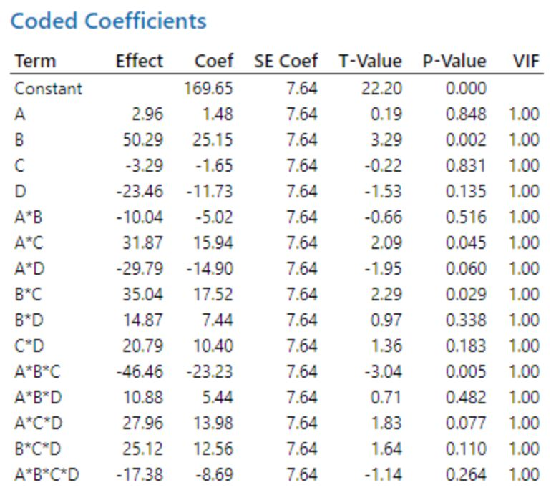
First Model Analysis
Significant Factors:
B: P value = 0.002
BC: P value = 0.029
AC: P value = 0.045
ABC: P value = 0.005

Slide 14
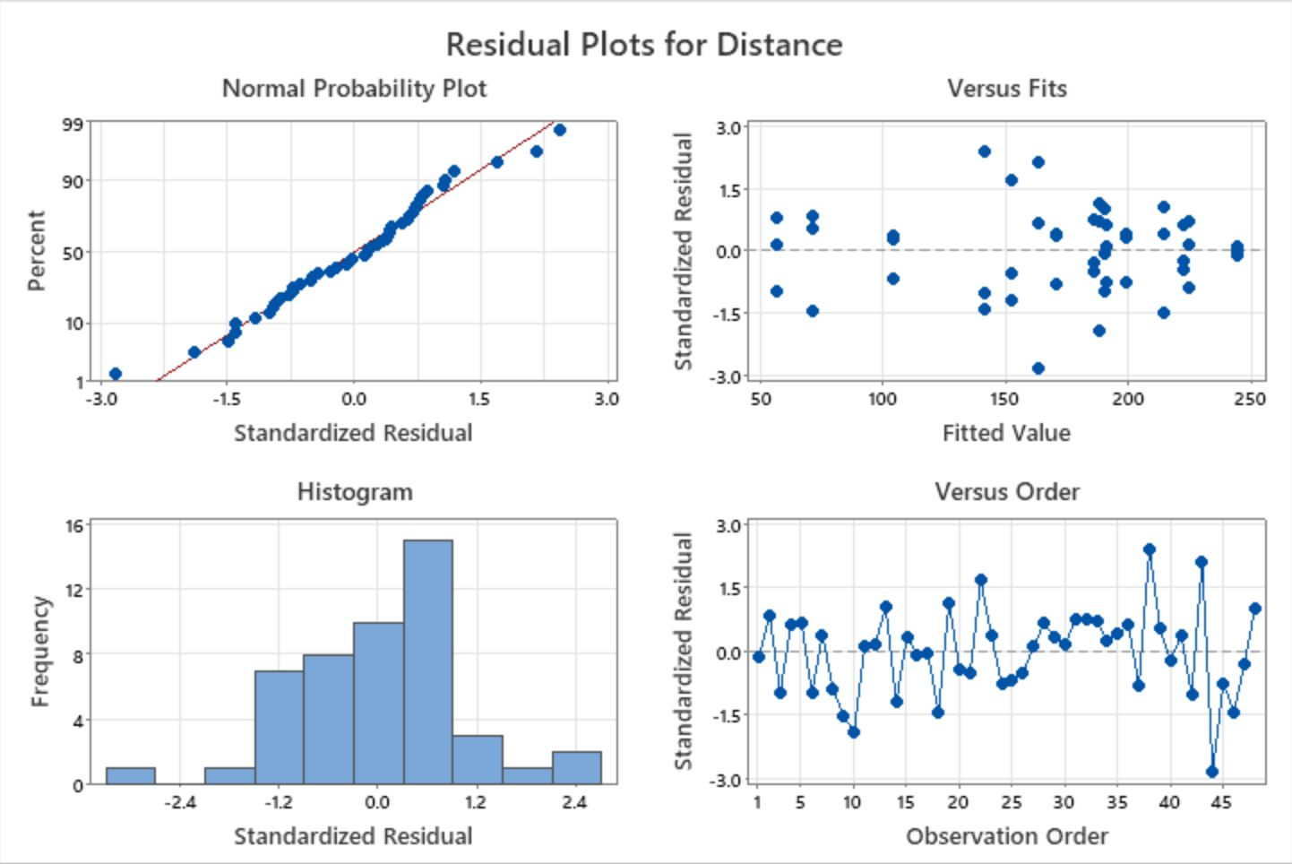
Residual Analysis: First Model
Does it follow NID
Normally Distributed:
Fat Pencil Test Passed
Histogram is skewed to the right
Equal Variance:
Pattern, violated equal variance assumption
Independence:
No patterns, looks independent
Next: Refine model (Sparsity Principle)

Slide 15
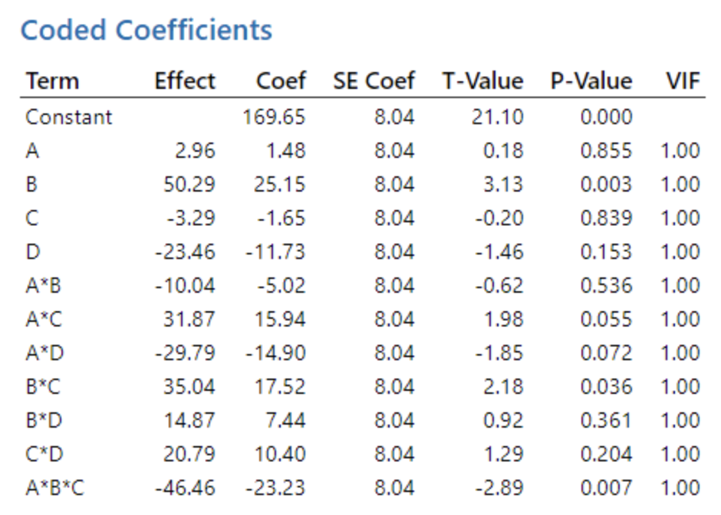
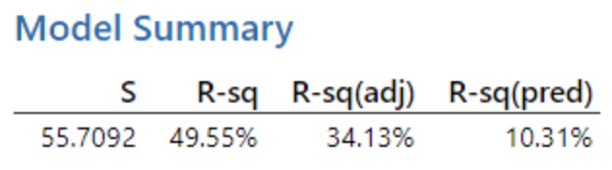
Refined Model
Standard Error (S) increased 2.756
R-sq decreased 9.93%
R-sq(adj) decreased 6.36%
R-sq(pred) increased 1.48%

Slide 16
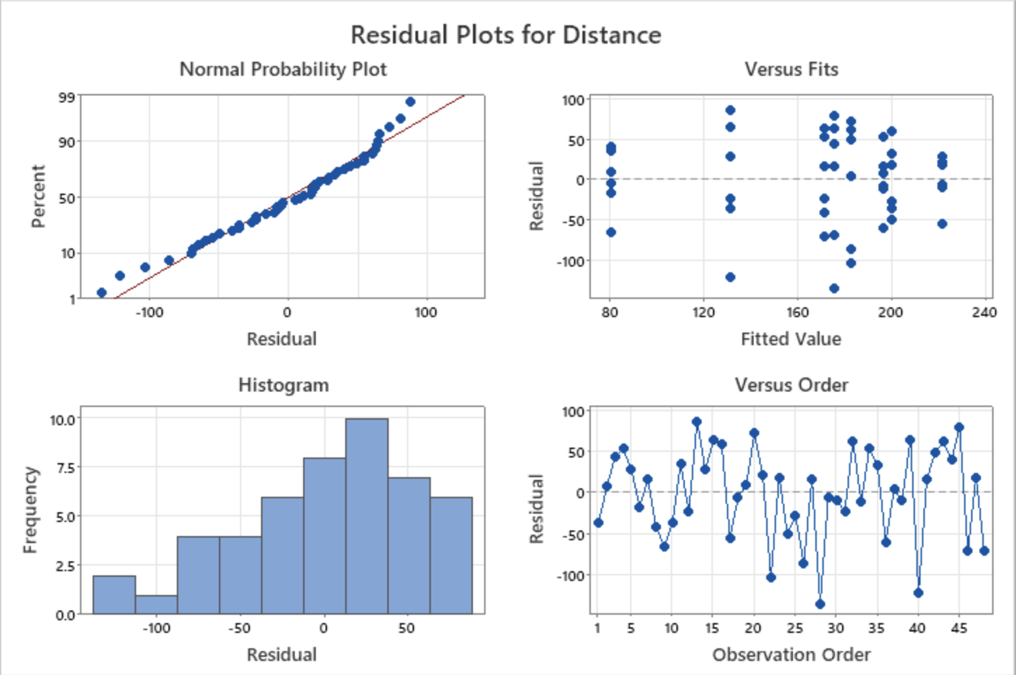
Residual Analysis: Refined Model
Does it follow NID
Normally Distributed:
Fat Pencil Test Pass
Histogram is skewed to the right
Equal Variance:
Pattern, violated equal variance assumption
Independence:
No patterns, looks independent

Slide 17
Analysis Conclusion
Model does not fit the data well.
Might Removed some variables which is important.
The increase of R-sq(pred) indicate that the model may perform better on new data.
Redo it without the non-significant factor D(Height) under the same variability

Slide 18

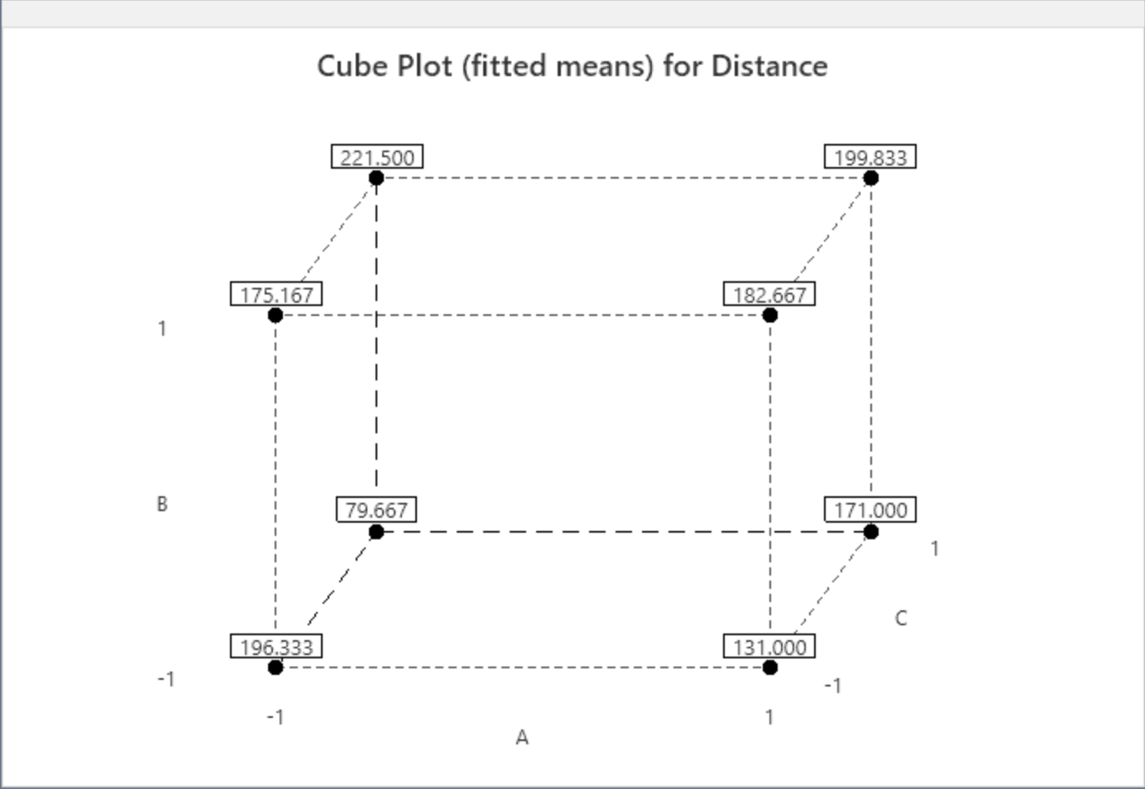

Winning model
BC is the Winning Model!!

Slide 19
Financial Analysis
A (Size of Wheels)
High: $8800
Low: $4000
B (Length of the Car)
Hight: $1200
Low: $1000
C (Wings)
High: $100
Low: $0
D (Height)
High: $3000
Low: $400
Winning Model: BC
Cost: $15,300
Other Significant Models Cost:
ABC: $20,100
B: $15,100

Slide 20
Conclusion & recommedations
B and C at high level performed the best.
Based on the R-sq(adj), our model didn’t perform well.
Do more replications with less variability in a better environment.
Redo the DOE only using three factors:
A: Size of Wheels
B: Length of the Car
C: Wings

